Slide 1
Connecting programs and proof
K. Rustan M. Leino
5 October 2026
SPLASH/ISSTA 2026 summer school
Oakland, CA, USA

Slide 2
Goals of tutorial
Demonstrate writing and debugging proofs of
  Imperative programs
  Functional programs
  Math theorems
Entice you to use Dafny for your next programming and proof project

Slide 3

Language
Dafny (dafny.org)
Programming language
  Verification-aware
  (proof-oriented)
Constructs for
  Imperative programming
  Functional programming
  Specifications
  Proofs
VS Code integration

Slide 4
Tools
Static verifier
Compilers from Dafny to
  Java
  C#
  JavaScript
  Go
  Python
  Rust
Auditor
Test generator

Slide 5
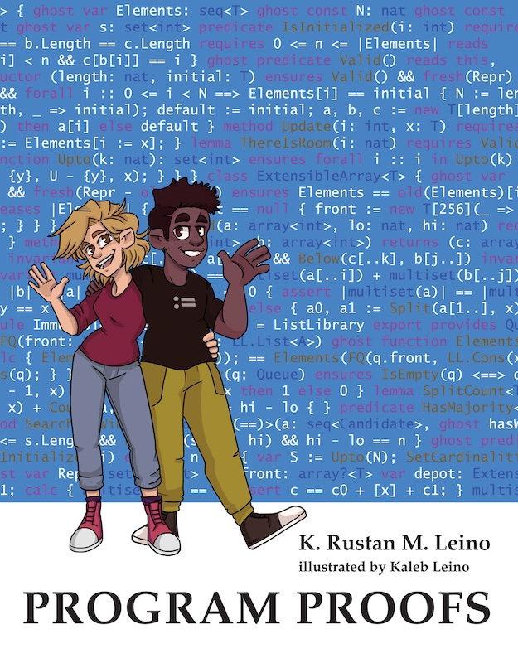

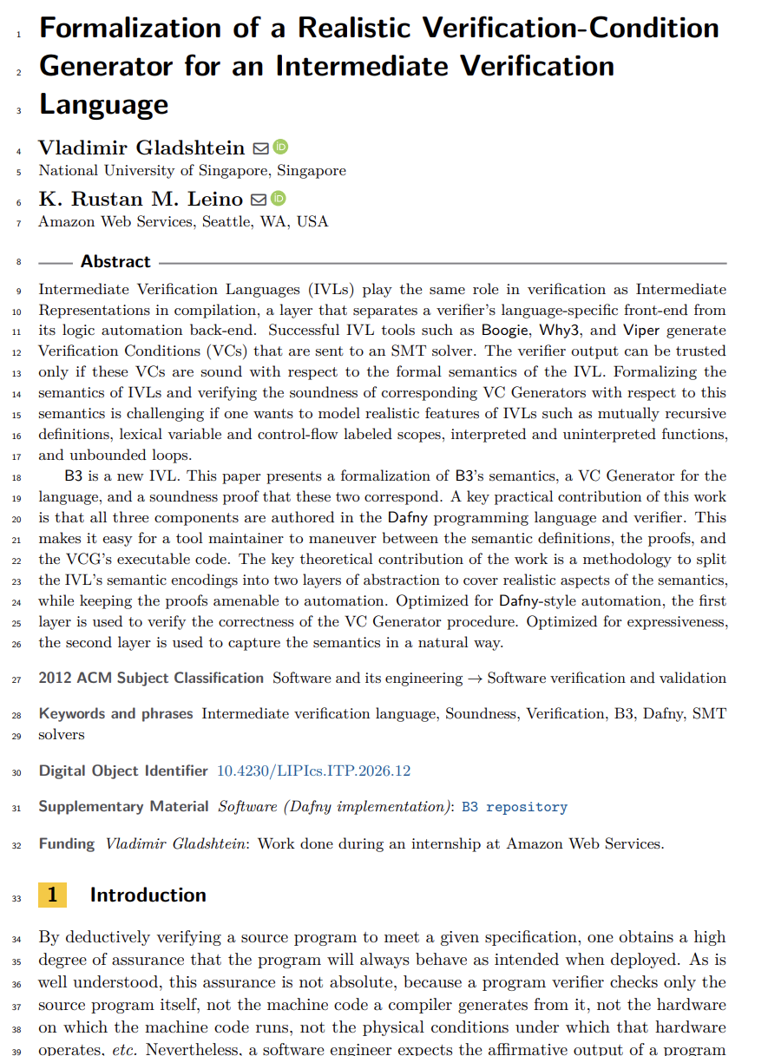
Some uses of Dafny
Teaching
  Over a decade, many universities
Industrial use
  AWS’s authorization engine
  Paper at ICSE 2025.
  Talk at AWS re:Inforce 2024:
  https://youtu.be/oshxAJGrwMU
Research projects
  Ironclad Apps, IronFleet, Armada, Vale, …
  Meta theory
ITP 2026

Slide 6
Demonstrations

Slide 7
newtype int32 = x: int | -0x8000_0000 <= x < 0x8000_0000
datatype Option<T> = None | Some(value: T)
method BinarySearch(a: array<int>, key: int) returns (r: Option<int32>)
requires a.Length < 0x8000_0000
requires forall i, j :: 0 <= i < j < a.Length ==> a[i] <= a[j]
ensures r.Some? ==> 0 <= r.value as int < a.Length && a[r.value] == key
ensures r == None ==> key !in a[..]
{
var lo, hi := 0, a.Length as int32;
while lo < hi
invariant 0 <= lo <= hi <= a.Length as int32
invariant key !in a[..lo] && key !in a[hi..]
{
var mid := lo + (hi - lo) / 2;
if key < a[mid] {
hi := mid;
} else if a[mid] < key {
lo := mid + 1;
} else {
return Some(mid);
}
}
return None;
}

Slide 8
function Sum(s: seq<int>, lo: nat, hi: nat): int
requires lo <= hi <= |s|
{
if lo == hi then 0 else Sum(s, lo, hi - 1) + s[hi - 1]
}
method PrefixSum(a: array<int>)
modifies a
ensures forall i :: 0 <= i < a.Length ==> a[i] == Sum(old(a[..]), 0, i + 1)
{
var ps := 0;
for n := 0 to a.Length
invariant forall i :: 0 <= i < n ==> a[i] == Sum(old(a[..]), 0, i + 1)
invariant ps == Sum(old(a[..]), 0, n)
invariant a[n..] == old(a[n..])
{
a[n] := ps + a[n];
ps := a[n];
}
}

Slide 9
method DetectDuplicate(a: array<int>, b: array<int>) returns (r: bool)
requires forall i :: 0 <= i < a.Length ==> 0 <= a[i] < 65536
requires b.Length == 65536 && a != b
modifies b
ensures r <==> exists i, j :: 0 <= i < j < a.Length && a[i] == a[j]
{
if 65536 < a.Length {
PigeonHolePrinciple(65536, a[..]);
return true;
}
for n := 0 to a.Length
invariant forall i, j :: 0 <= i < j < n ==> a[i] != a[j]
invariant forall x :: 0 <= x < 65536 ==>
(x in a[..n] <==> 0 <= b[x] < n && a[b[x]] == x)
{
var x := a[n];
if 0 <= b[x] < n && a[b[x]] == x {
return true;
}
b[x] := n;
}
return false;
}

Slide 10
lemma PigeonHolePrinciple(n: nat, s: seq<int>)
requires n < |s|
requires forall i :: 0 <= i < |s| ==> 0 <= s[i] < n
ensures exists i, j :: 0 <= i < j < |s| && s[i] == s[j]
{
if exists i, j :: 0 <= i < j < |s| && s[i] == s[j] {
return;
}
var x := n - 1;
if x in s {
var i :| 0 <= i < |s| && s[i] == x;
var t := s[..i] + s[i+1..];
PigeonHolePrinciple(n - 1, t);
} else {
PigeonHolePrinciple(n - 1, s);
}
}

Slide 11
Conclusion
Use Dafny to
Write verified programs
Write a verified component of a larger program written in some other language
Formalize models
Teach!
Program safely!

