Slide 1
Tools for software verification an industrial perspective
K. Rustan M. Leino
Amazon Web Services
24 June 2025
LICS 2025
Singapore

Slide 2


Why verify software
Because it’s the right thing to do
Because idealists tell you to
Because it will reduce time to reach release quality

Slide 3
When to verify software
When testing is too incomplete
When failure would be too expensive
When it’s a competitive advantage
When code has been statistically generated

Slide 4
Other benefits of the process of proving programs
Writing specifications
Thinking of design before coding
Spending more time with the design and code
Isolating places of errors

Slide 5
Brief survey of some techniques
Testing
Static analysis
Model checking
Deductive verification

Slide 6
Technique:
Testing
Idea is easy to understand
Unsound (misses bugs)
Requires downward-closed program
May be difficult to set up environment

Slide 7
Technique:
Static analysis
type systems, abstract interpretation, data-flow analysis, …
Sound (finds all bugs)
Easy to apply
Modular
Type-like properties, coarse-grained
User-extensible
Some successes at AWS:
Minimum encryption-key width (Java CheckerFramework)
Builder idiom parameter initialization (Java CheckerFramework)
TypeScript type/property recovery (Jitterbug)

Slide 8
Technique:
Model checking
bounded modeling checking, systematic scheduling,
run-time monitors, …
Unsound (bounded model checking)
Systematic and detailed
Modular
Can use specifications
Hands-off
Easy to understand error traces
Some successes at AWS:
Memory safety (CBMC)
Protocol modeling (P)
Concurrency bugs (Shuttle)

Slide 9
Technique:
Deductive verification
interactive theorem proving,
interactive program proving
Sound
Supports specifications
Requires interaction when automation runs out
Spec/program/proof co-development
Requires expertise and patience
Some successes at AWS:
AWS Libcrypto (HOL Light)
s2n-bignum (HOL Light)
AWS authentication engine (Dafny)
AWS Encryption SDK, AWS Datatype Encryption SDK (Dafny)

Slide 10

Interactive program proving
Dafny (dafny.org)
Programming language
  Verification-aware
  (proof-oriented)
Constructs for
  Imperative programming
  Functional programming
  Specifications
  Proofs
VS Code integration

Slide 11
Demo
Partition, InsertionSort

Slide 12
method Partition(a: array<int>, pivot: int) returns (k: nat)
modifies a
ensures k <= a.Length
ensures forall i :: 0 <= i < k ==> a[i] < pivot
ensures forall i :: k <= i < a.Length ==> pivot <= a[i]
ensures multiset(a[..]) == multiset(old(a[..]))
{
var j := 0;
k := a.Length;
while j < k
invariant 0 <= j <= k <= a.Length
invariant forall i :: 0 <= i < j ==> a[i] < pivot
invariant forall i :: k <= i < a.Length ==> pivot <= a[i]
invariant multiset(a[..]) == multiset(old(a[..]))
{
if a[j] < pivot {
j := j + 1;
} else if pivot <= a[k-1] {
k := k - 1;
} else {
a[j], a[k-1] := a[k-1], a[j];
j, k := j + 1, k - 1;
}
}
}

Slide 13
datatype List<X> =
Nil | Cons(head: X, tail: List<X>)
function Elements<X>(xs: List<X>): multiset<X> {
match xs
case Nil => multiset{}
case Cons(x, tail) =>
multiset{x} + Elements(tail)
}
function Insert(xs: List<int>, y: int): List<int> {
match xs
case Nil => Cons(y, Nil)
case Cons(x, tail) =>
if y <= x then Cons(y, xs)
else Cons(x, Insert(tail, y))
}
function InsertionSort(xs: List<int>): List<int> {
match xs
case Nil => Nil
case Cons(x, tail) =>
Insert(InsertionSort(tail), x)
}
predicate Sorted(xs: List<int>) {
match xs
case Cons(x, Cons(y, _)) => x <= y && Sorted(xs.tail)
case _ => true
}
lemma InsertionSortCorrect(xs: List<int>)
ensures Sorted(InsertionSort(xs))
ensures Elements(InsertionSort(xs)) == Elements(xs)
{
match xs
case Nil =>
case Cons(x, tail) =>
InsertCorrect(InsertionSort(tail), x);
}
lemma InsertCorrect(xs: List<int>, y: int)
requires Sorted(xs)
ensures Sorted(Insert(xs, y))
ensures Elements(Insert(xs, y))
== multiset{y} + Elements(xs)
{
}

Slide 14
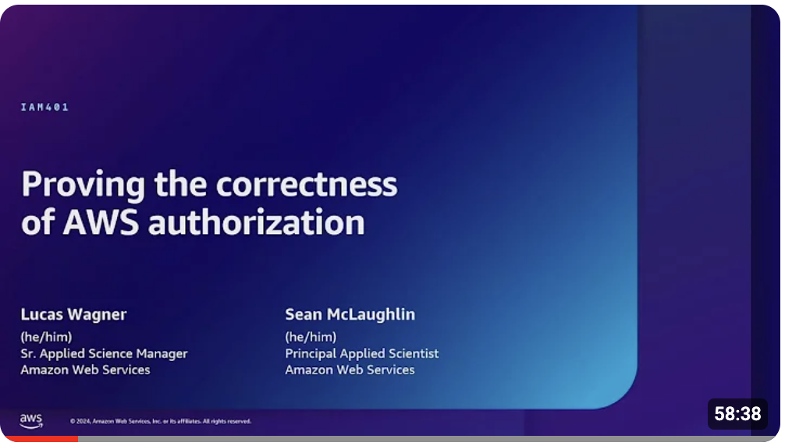
Some AWS uses of Dafny
AWS’s authentication engine
  Talk at AWS re:Inforce 2024:
  https://youtu.be/oshxAJGrwMU?si=2HRf2XvNR-8RMIXZ
  Paper at ICSE 2025

Slide 15
Some AWS uses of Dafny
AWS Encryption SDK
  https://github.com/aws/aws-encryption-sdk
AWS Database Encryption SDK
  https://docs.aws.amazon.com/database-encryption-sdk/latest/devguide/what-is-database-encryption-sdk.html

Slide 16
Demo
Wildcard match

Slide 17
predicate Match(pattern: string, text: string) {
if pattern == "" && text == "" then
f true
else if pattern == "" then
false
else if text == "" then
&& pattern[0] == ‘*’
&& Match(pattern[1..], text)
else if pattern[0] != '*' then
&& (pattern[0] == '?' || pattern[0] == text[0])
&& Match(pattern[1..], text[1..])
else
|| Match(pattern[1..], text)
|| Match(pattern, text[1..])
}
Notes:
module OperationalSpecification {
predicate Match(pattern: string, text: string) {
if pattern == "" && text == "" then
true
else if pattern == "" then
false
else if text == "" then
&& pattern[0] == '*'
&& Match(pattern[1..], text)
else if pattern[0] != '*' then
&& (pattern[0] == '?' || pattern[0] == text[0])
&& Match(pattern[1..], text[1..])
else
|| Match(pattern[1..], text)
|| Match(pattern, text[1..])
}
}
module DeclarativeSpecification {
predicate ValidExpansion1(patternChar: char, s: string) {
match patternChar
case '*' => true
case '?' => |s| == 1
case _ => |s| == 1 && patternChar == s[0]
}
predicate ValidExpansion(pattern: string, segments: seq<string>) {
&& |pattern| == |segments|
&& forall i :: 0 <= i < |pattern| ==> ValidExpansion1(pattern[i], segments[i])
}
ghost predicate Match(pattern: string, text: string) {
exists segments :: ValidExpansion(pattern, segments) && Concat(segments) == text
}
function Concat<X>(segments: seq<seq<X>>): seq<X> {
if segments == [] then [] else segments[0] + Concat(segments[1..])
}
}
module ProofOfEquivalence {
import Op = OperationalSpecification
import D = DeclarativeSpecification
lemma SameDefinition(pattern: string, text: string)
ensures D.Match(pattern, text) == Op.Match(pattern, text)
{
if Op.Match(pattern, text) {
var segments := Ping(pattern, text);
}
if D.Match(pattern, text) {
var segments := SegmentsFromMatch(pattern, text);
Pong(pattern, segments, text);
}
}
lemma Ping(pattern: string, text: string) returns (segments: seq<string>)
requires Op.Match(pattern, text)
ensures D.ValidExpansion(pattern, segments) && D.Concat(segments) == text
{
// This proof follows the structure of Y.Match
if pattern == "" && text == "" {
segments := [];
} else if pattern == "" {
assert false;
} else if text == "" {
segments := Ping(pattern[1..], text);
segments := [""] + segments;
} else if pattern[0] != '*' {
segments := Ping(pattern[1..], text[1..]);
segments := [[text[0]]] + segments;
} else if Op.Match(pattern[1..], text) {
segments := Ping(pattern[1..], text);
segments := [""] + segments;
} else {
assert Op.Match(pattern, text[1..]);
segments := Ping(pattern, text[1..]);
segments := [[text[0]] + segments[0]] + segments[1..];
}
}
lemma Pong(pattern: string, segments: seq<string>, text: string)
requires D.ValidExpansion(pattern, segments) && D.Concat(segments) == text
ensures Op.Match(pattern, text)
decreases pattern, text
{
if pattern == "" {
// trivial
} else {
var patternChar := pattern[0];
match patternChar
case '*' =>
var segment := segments[0];
if |segment| == 0 {
Pong(pattern[1..], segments[1..], text);
} else {
Pong(pattern, [segment[1..]] + segments[1..], text[1..]);
}
case '?' =>
Pong(pattern[1..], segments[1..], text[1..]);
case _ =>
Pong(pattern[1..], segments[1..], text[1..]);
}
}
lemma SegmentsFromMatch(pattern: string, text: string) returns (segments: seq<string>)
requires D.Match(pattern, text)
ensures D.ValidExpansion(pattern, segments) && D.Concat(segments) == text
{
segments :| D.ValidExpansion(pattern, segments) && D.Concat(segments) == text;
}
}

Slide 18
predicate ValidExpansion1(patternChar: char, s: string) {
match patternChar
case '*' => true
case '?' => |s| == 1
case _ => |s| == 1 && patternChar == s[0]
}
predicate ValidExpansion(pattern: string, segments: seq<string>) {
&& |pattern| == |segments|
&& forall i :: 0 <= i < |pattern| ==> ValidExpansion1(pattern[i], segments[i])
}
ghost predicate MatchSpec(pattern: string, text: string) {
exists segments ::
ValidExpansion(pattern, segments) && Concat(segments) == text
}

Slide 19
lemma SameDefinition(pattern: string, text: string)
ensures MatchSpec(pattern, text) == Match(pattern, text)
{
if Match(pattern, text) {
var segments := Ping(pattern, text);
}
if MatchSpec(pattern, text) {
var segments := SegmentsFromMatch(pattern, text);
Pong(pattern, segments, text);
}
}
…

Slide 20
How it’s done
Interaction at the level of programs
  “auto-active verification”
  Dafny, Java verifier, Verus, …
In CI or proof didn’t happen
Syntax/constructs matter
Dafny→Java or Java→Dafny ?

Slide 21
Demo
Stream, Semantics

Slide 22
codatatype Stream<X> = More(head: X, tail: Stream<X>)
function From(x: int): Stream<int> {
More(x, From(x + 1))
}
function EveryOther<X>(s: Stream<X>): Stream<X> {
More(s.head, EveryOther(s.tail.tail))
}
greatest predicate Even(s: Stream<int>) {
s.head % 2 == 0 && Even(s.tail)
}
greatest lemma FromEvenIsEven(x: int)
requires x % 2 == 0
ensures Even(EveryOther(From(x)))
{
var s := From(x);
assert s.tail == From(x + 1);
var t := s.tail.tail;
assert s == More(x, More(x + 1, t));
assert t == From(x + 2);
assert t.head == x + 2;
FromEvenIsEven(x + 2);
}

Slide 23
datatype Stmt =
| VarDecl(v: Variable)
| ValDecl(v: Variable, rhs: Expr)
| Assign(lhs: string, rhs: Expr)
| Block(lbl: Label, stmts: seq<Stmt>)
| Call(name: string, args: seq<CallArgument>)
| Check(cond: Expr)
| Assume(cond: Expr)
| Assert(cond: Expr)
| If(cond: Expr, thn: Stmt, els: Stmt)
| IfCase(cases: seq<Case>)
| Loop(lbl: Label, invariants: seq<Expr>, body: Stmt)
| Exit(lbl: Label)
| Return
datatype State =
| State(m: Valuation, shadowedVariables: Valuation)
| AbruptExit(lbl: Label, m: Valuation, shadowedVariables: Valuation)
| Error

Slide 24
greatest predicate BigStep(stmt: Stmt, b3: Program, st: State, st': State)
requires st.State?
{
match stmt
case VarDecl(v) =>
exists val :: HasType(val, v.typ) && st' == st.SaveAsShadow(v.name).Update(v.name, val)
case ValDecl(v, rhs) =>
st' == st.SaveAsShadow(v.name).Update(v.name, rhs.Eval(st.m))
case Assign(lhs, rhs) =>
st' == st.Update(lhs, rhs.Eval(st.m))
case Block(lbl, stmts) =>
exists mid :: BigStepSeq(stmts, b3, st.ClearShadows(), mid) && st' == mid.Lower(lbl).RestoreScope(st)
case Call(name, args) =>
BigStepCall(stmt, b3, st, st’)
case Check(cond) =>
if cond.Eval(st.m) == True then st' == st else st' == Error
case Assume(cond) =>
cond.Eval(st.m) == True && st' == st
case Assert(cond) =>
if cond.Eval(st.m) == True then st' == st else st' == Error
case If(cond, thn, els) =>
BigStep(if cond.Eval(st.m) == True then thn else els, b3, st, st’)
case IfCase(cases) =>
exists cs <- cases :: cs.cond.Eval(st.m) == True && BigStep(cs.body, b3, st, st’)
case Loop(lbl, invariants, body) =>
exists st0 ::
var checks := seq(|invariants|, i requires 0 <= i < |invariants| => Assert(invariants[i]));
BigStepSeq(checks, b3, st, st0) &&
if !st0.State? thenst' == st0
else
exists st1 ::
BigStep(body, b3, st0, st1) &&
if !st1.State? then st' == st1.Lower(lbl)
else BigStep(stmt, b3, st1, st’)
case Exit(lbl) =>
st' == st.Raise(lbl)
case Return =>
st' == st.Raise(ReturnLabel)
}
…

Slide 25
Difficulties
Introducing another language and/or tool
Training
Keeping up IDE expectations
Libraries need specifications
Extern specifications are error prone

Slide 26
Logic/type features/issues in Dafny
Many of these are waiting for theorems to be written
Classic (not intuitionistic) logic
Partial functions
Types can be empty
Axiom of choice
Predicates defined by least/greatest fixpoint
ORDINAL type (is it ”large enough”?)
Quantification over function values (cardinality issue in first-order encoding?)
Abstract supertypes (traits)
Datatypes and codatatypes
Subset types (aka predicate subtypes or refinement types)
Bounded polymorphism
Type-parameter variance and cardinality restrictions
Weakest precondition of var x: T where type T is empty
Tail-recursion modulo ghosts
Termination–general well-founded recursion/induction

Slide 27
Conclusions
Software verification is in use and useful
Many hurdles remain, technical and social
Teach!

