Slide 1
Dafny
2025 State of the Union
Address
K. Rustan M. Leino
Amazon Web Services
Keynote, Dafny Workshop 2025
Denver, CO, USA
19 January 2025

Slide 2
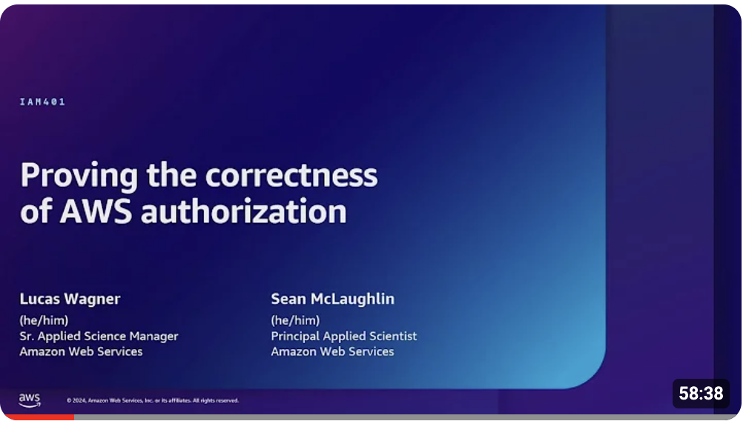
New applications
AWS Authentication Engine
Most impactful formal verification project to date?
Talk at AWS re:Inforce 2024:
https://youtu.be/oshxAJGrwMU?si=2HRf2XvNR-8RMIXZ
AWS Encryption SDK
Authored in Dafny, now released for 5 language platforms
https://aws.amazon.com/about-aws/whats-new/2025/01/aws-encryption-sdk-go-available/
AI applications (see today’s schedule)
What are some of yours?

Slide 3
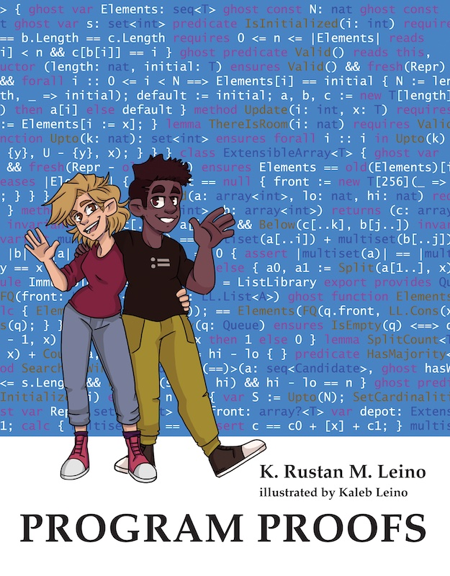
Teaching
Program Proofs
K. Rustan M. Leino (MIT Press, 2023)
Specification and Verification of Distributed Protocols
Manos Kapritsos and Jon Howell
https://glados-michigan.github.io/verification-class/2022/
Training material used at AWS
John Tristan
https://dafny.org/blog/2023/12/15/teaching-program-verification-in-dafny-at-amazon/
https://dafny.org/teaching-material/
6.S057 Verified Software Engineering (MIT)
Adam Chlipala and K. Rustan M. Leino, Spring 2025
What is some of your class material?

Slide 4
Community
New: Zulip channel
dafny.zulipchat.com/
Coming soon: Redesigned web site
dafny.org
We want more actively to encourage open-source contributions
a Dafny online playground
and a format for interactive Jupyter-like tutorials
WANTED

Slide 5
Tool set
Doc comments
JUnit/XUnit-like test automation
Test generation
QuickCheck for Dafny
Auditor
Interface Description Language: Smithy-Dafny
Boogie extractor
Standard library
  Soon: Streaming library
  Some parts need redesign
WANTED
WANTED

Slide 6
Invoking Dafny
Project files
No more include directives!
Verb-based Command-Line Interface
  dafny verify MyFile.dfy
  dafny run dfyconfig.toml
dfyconfig.toml
includes = ["*.dfy"]
[options]
warn-shadowing = true

Slide 7
Types
Basic types
  bool
  char
  int
  real
  bv0, bv1, bv2, …
  ORDINAL
Immutable structures
  datatype
  codatatype
  tuples (built-in special cases of datatypes)
Built-in (immutable) collections
  set, iset
  seq
  multiset
  map, imap
(Monomorphic) arrow types
  ~>
References to mutable storage
  class
  array, array2, array3, …

Slide 8
Updated type system
Reimplementation of type inference/checking
To use it now:
  --type-system-refresh
  --general-traits=datatype
  --general-newtypes
Will become default in a future release

Slide 9
Subset types
(cf. refinement types, predicate subtypes)
type MyType = x: BaseType | Constraint(x)
Built-ins
  nat
  -->
  ->
Constraint cannot depend on mutable state
Cannot declare members
Type system allows assignments between MyType and BaseType in both directions
  Verifier enforces constraints
New: types of bound variables always inferred as base types
  forall x :: P(x)

Slide 10
Traits
(cf. interfaces, type classes)
trait MyTrait {
// members
}
Can have data members
New: Can be implemented by any type that supports members (i.e., not subset types)
Extending the built-in trait object makes a type a reference type
A class automatically extends object

Slide 11
Newtypes
(cf. derived types)
newtype N = BaseType
New: Allows type parameters
New: BaseType can be any non-trait, non-reference type
  except datatypes
A newtype is not allowed to extend traits
  Needs support for fat pointers in the compilers
Syntax allows a constraint, but this is better viewed as declaring both a subset type and a newtype
WANTED
WANTED

Slide 12
Type tests and conversions
New: Expanded support for
  type tests (is) and
  type conversions (as)

Slide 13
Type parameters
Variance
Cardinality preservation
Test-type (is) restriction to preserve parametric polymorphism
  Coincidentally, this helps multi-target compilation
  But is it otherwise of importance?
New: Type bounds (bounded polymorphism)
  method MyMethod<T extends MyTrait>(x: T)
  Bounds are traits or subset types thereof
  Supports multiple bounds
  Requires some casts when using as one of the bounds
    Embellish type inference to not require these casts
  Allow any type as a bound
HELP
WANTED
WANTED

Slide 14
Proof organization and stabilization
assert PropertyIWantToProve by {
// proof goes here
}
New: by clauses on all statements
New: opaque code blocks
New: hide statements (≈ dual of reveal)
New: {:only}
  Temporarily focuses proof effort on the selected component

Slide 15
Internal changes to improve prover performance and stability
Clean up encoding of functions: CanCall
Direct verifier in how to use automatic induction hypotheses
Coming soon:
  Improved encoding of fuel
  Change in automatic unfolding for literal arguments to functions
  (probably)
Still an issue: encoding of allocatedness
Bugs found and fixed in Z3
  Dafny will update its Z3 version in Dafny 5.0 (or sooner)
class C {
var data: int
…
}
method M(d: C) {
var c := new C();
assert c != d;
c.data := 10;
}

Slide 16
Other new language features
@-attributes
  @SomeAttribute(params) alternative to
  {:someAttribute params}
  More control and checking
Parameter default values
decreases to expressions
forall statements in expressions
Sometimes, {:axiom} is required to confirm missing information
method M(a: int,
b: int := 25,
c: int := d + 1,
d: int := 100)
…
M(2, 4, d := 90) // calls M(2, 4, 91, 90)

Slide 17
Rustan’s feature wish list
Regions, linearity, uniqueness
  Abstraction, simpler specifications
  Better verifier performance
  Compiler optimizations
  Concurrency
Systems programming features (nominally unsafe memory)
Named quantifiers
  A new way to present quantifiers to users
Letting subset constraint be declared as ghost or compiled
  Compiled by default, ghost indicates ghost
Stop requiring types to be auto-init by default
seq/array constructors with pseudo-lambda expressions
^ and + for indexing and ranges
  s[^1] means s[|s| – 1]
  s[n..+2] means s[n..n+2]
Redesign semantics of function values
Post-declaration implementation of traits
Change type characteristics to use traits
Type invariant (only for immutable state)
Better IDE support for writing proofs
WANTED
WANTED
WANTED

Slide 18
SMT solving
SMT research on quantifiers and matching patterns (triggers)
Some of my assumptions were wrong
  Triggers are not used in clause learning
A minimal SMT solver with
  arithmetic (integer, real, bitvectors)
  uninterpreted function symbols
  quantifiers
Triggers with guards
  Cf. Egg
  Cf. work by Jhala, Vazou, et al.

Slide 19
Open design questions
Termination for dynamic dispatch
Termination for applications of function values
Scope of well-formedness checks
Future of multi-target compilation
Native compiler for Dafny
Verified compiler (see Dafny/CakeML talk later today)

Slide 20
Conclusions
This is an exciting time for software program proofs

