Slide 1
Using Dafny to write correct programs
K. Rustan M. Leino
Amazon Web Services
21 October 2024
TU Vienna
Vienna, Austria

Slide 2
Formal verification
Sometimes, testing isn’t enough
Sometimes, there’s no reason to have any bugs
Formal verification checks every behavior for every input and every environment
Learning to reason formally is a great guide also for day-to-day informal reasoning

Slide 3

Language
Dafny (dafny.org)
Programming language
  Java-like
  Verification-aware
  (proof-oriented)
Constructs for
  Imperative programming
  Functional programming
  Specifications
  Proofs
VS Code integration

Slide 4
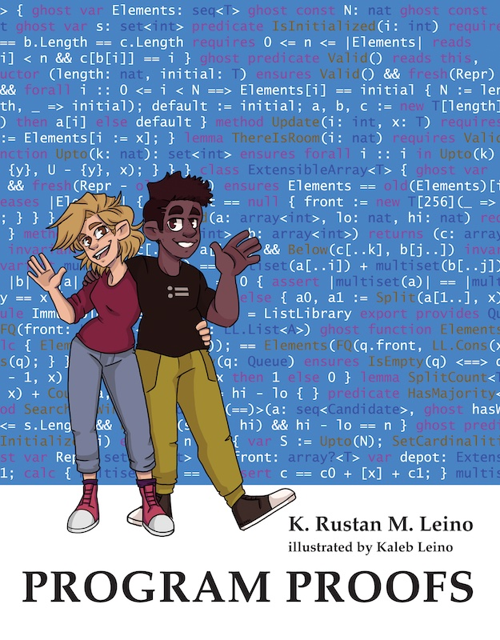

Some uses of Dafny
Teaching
  Over a decade, many universities
  Book (MIT Press): program-proofs.com
At AWS
  AWS Encryption SDK
  AWS Database Encryption SDK
  AWS’s authentication engine
  Talk at AWS re:Inforce 2024:
  https://youtu.be/oshxAJGrwMU?si=2HRf2XvNR-8RMIXZ
  …
…

Slide 5
Methods and pre-/post-conditions
method Split(c: int) returns (a: int, b: int)
requires 0 <= c < 10_000
ensures 0 <= a < 100 && 0 <= b < 100
ensures c == 100 * a + b
{
a := c / 100;
b := c % 100;
}
method Combine(a: int, b: int) returns (c: int)
requires 0 <= a < 100 && 0 <= b < 100
ensures 0 <= c < 10_000
ensures c == 100 * a + b
{
if a == 0 {
c := b;
} else if a == 1 {
c := 100 + b;
} else {
c := 100 * a + b;
}
}
method Caller(c: int)
requires 0 <= c
{
if c < 10_000 {
var a, b := Split(c);
var d := Combine(a, b);
assert c == d;
}
}

Slide 6
Reasoning about loops
Loop invariant is
to hold here
while GuardExpr
{
Body
}
Check loop invariant here
Here we know:
Invariant && GuardExpr
Invariant && !GuardExpr

Slide 7
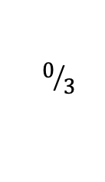
A simple loop
Square.dfy
$$0/3$$
method Square(n: nat) returns (s: nat)
ensures s == n * n
{
s := 0;
var i := 0;
while i < n
invariant 0 <= i <= n
invariant s == i * i
{
i := i + 1;
}
}
❓

Slide 8
Figuring out what’s needed
assert
x := E;
assert Condition;
the Condition, but with
x replaced by E
❓
Condition[x := E];

Slide 9
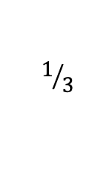
A simple loop
Square.dfy
$$1/3$$
method Square(n: nat) returns (s: nat)
ensures s == n * n
{
s := 0;
var i := 0;
while i < n
invariant 0 <= i <= n
invariant s == i * i
{
assert s == i * i + 2 * i + 1;
assert s == (i + 1) * (i + 1);
i := i + 1;
assert s == i * i;
}
}
❓

Slide 10
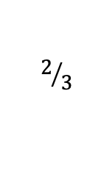
A simple loop
Square.dfy
$$2/3$$
method Square(n: nat) returns (s: nat)
ensures s == n * n
{
s := 0;
var i := 0;
while i < n
invariant 0 <= i <= n
invariant s == i * i
{
s := s + 2 * i + 1;
i := i + 1;
}
}

Slide 11
Linear Fibonacci
function Fib(n: nat): nat {
if n < 2 then n else Fib(n - 2) + Fib(n - 1)
}
method ComputeFib(n: nat) returns (x: nat)
ensures x == Fib(n)
{
x := 0;
var y, i := 1, 0;
while i < n
invariant 0 <= i <= n
invariant x == Fib(i) && y == Fib(i + 1)
{
x, y := y, x + y;
i := i + 1;
}
}

Slide 12

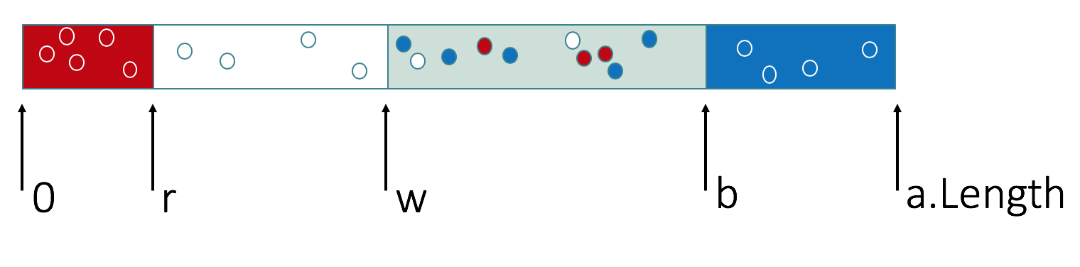
Dutch National Flag

Slide 13
Dutch National Flag
datatype Color = Red | White | Blue
function InOrder(c: Color, d: Color): bool {
c == Red || c == d || d == Blue
}
method DutchFlag(a: array<Color>)
modifies a
ensures forall i, j :: 0 <= i < j < a.Length ==> InOrder(a[i], a[j])
ensures multiset(a[..]) == old(multiset(a[..]))
{
var r, w, b := 0, 0, a.Length;
while w != b
invariant 0 <= r <= w <= b <= a.Length
invariant forall i :: 0 <= i < r ==> a[i] == Red
invariant forall i :: r <= i < w ==> a[i] == White
invariant forall i :: b <= i < a.Length ==> a[i] == Blue
invariant multiset(a[..]) == old(multiset(a[..]))
{
if a[w] == Red {
a[r], a[w] := a[w], a[r];
r, w := r + 1, w + 1;
} else if a[w] == White {
w := w + 1;
} else {
b := b - 1;
a[w], a[b] := a[b], a[w];
}
}
}

Slide 14
Conclusion
Use Dafny to
Write verified programs
Write a verified part of a larger program written in some other language
Formalize your models
Learn, and teach!
Program safely!

