Slide 1
Induction in deductive reasoning
K. Rustan M. Leino
Amazon Web Services
12-16 August 2024
Marktoberdorf Summer School 2024
Herrsching, Germany

Slide 2
Goal of lectures
To give a perspective on
induction / well-founded recursion
as a common thread in
programming, function definitions, and proofs
Take-home message:
You can call whatever you want whenever you want, provided
  you satisfy the precondition, and
  you can show a decrease in some fixed well-founded order
Lecture 0

Slide 3

Vehicle for our journey
Dafny (dafny.org)
Programming language
  Java-like
  Verification-aware
  (proof-oriented)
Constructs for
  Imperative programming
  Functional programming
  Specifications
  Proofs
VS Code integration

Slide 4
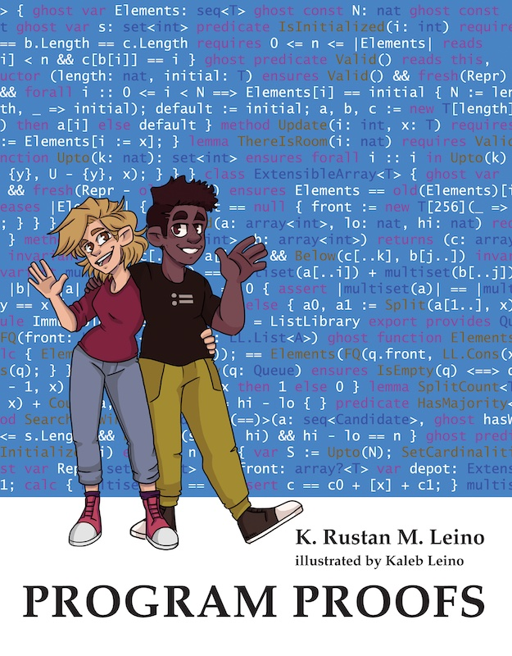

Some uses of Dafny
Teaching
  Over a decade, many universities
  Book (MIT Press): program-proofs.com
At AWS
  AWS Encryption SDK
  AWS Database Encryption SDK
  AWS’s authentication engine
  Talk at AWS re:Inforce 2024:
  https://youtu.be/oshxAJGrwMU?si=2HRf2XvNR-8RMIXZ
  …
…

Slide 5
Methods and pre-/post-conditions
CombineSplit.dfy
method Split(c: int) returns (a: int, b: int)
requires 0 <= c < 10_000
ensures 0 <= a < 100 && 0 <= b < 100
ensures c == 100 * a + b
{
a := c / 100;
b := c % 100;
}
method Combine(a: int, b: int) returns (c: int)
requires 0 <= a < 100 && 0 <= b < 100
ensures 0 <= c < 10_000
ensures c == 100 * a + b
{
if a == 0 {
c := b;
} else if a == 1 {
c := 100 + b;
} else {
c := 100 * a + b;
}
}
method Caller(c: int)
requires 0 <= c < 10_000
{
var a, b := Split(c);
var d := Combine(a, b);
assert c == d;
}

Slide 6
Interacting with the verifier
Min.dfy
method Min(s: seq<int>) returns (m: int)
requires |s| != 0
ensures m in s
ensures forall j :: 0 <= j < |s| ==> m <= s[j]
{
m := s[0];
for i := 1 to |s|
invariant m in s
invariant forall j :: 0 <= j < i ==> m <= s[j]
{
if s[i] < m {
m := s[i];
}
}
}

Slide 7
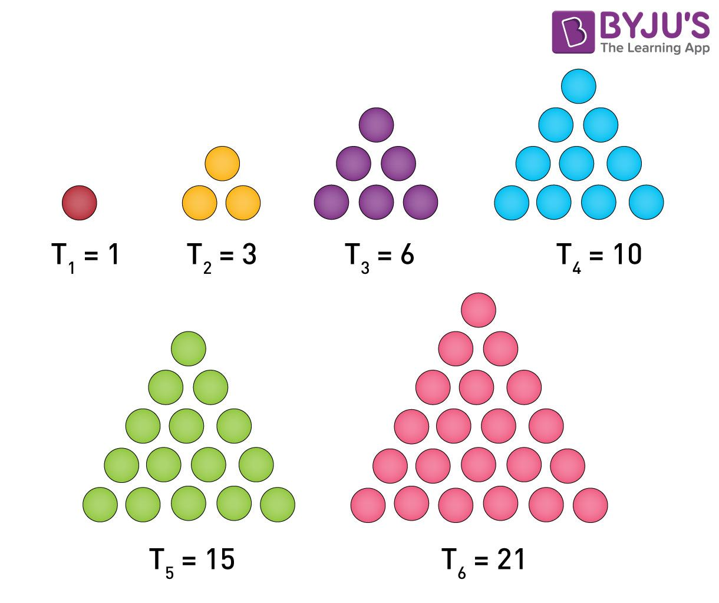
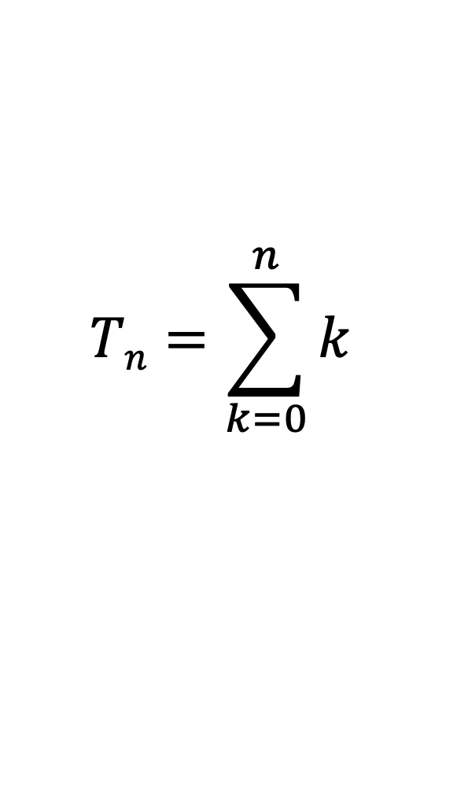
Triangle numbers
function Triangle(n: nat): nat {
if n == 0 then 0 else Triangle(n – 1) + n
}
$$Tn=\sum_{k=0}^{n}{k}$$
Image credit: byjus.com

Slide 8
Methods vs functions
method M(x: int) returns (y: int) {
<statements>
}
Can mutate state
Can be nondeterministic
Opaque (reasoning uses specification, never the body)
function F(x: int): int {
<expr>
}
Cannot mutate state
Deterministic
Transparent (reasoning uses body) – default
or opaque

Slide 9
Statements vs expressions
statement | expression
if G { <statements> } else { <statements> } | if G then <expr> else <expr>
match E case Nil => <statements> case Cons(x, tail) => <statements> | match E case Nil => <expr> case Cons(x, tail) => <expr>
optional

Slide 10
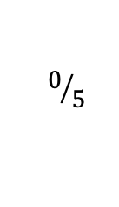
Methods and lemmas
Triangle.dfy
$$0/5$$
method Gauss(n: nat) returns (t: nat)
ensures t == Triangle(n)
{
t := 0;
var i := 0;
while i < n
invariant 0 <= i <= n
invariant t == Triangle(i)
{
i := i + 1;
t := t + i;
}
}

Slide 11
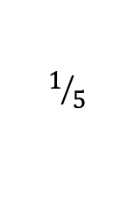
Methods and lemmas
Triangle.dfy
$$1/5$$
method Gauss(n: nat) returns (t: nat)
ensures t == Triangle(n)
ensures t == n * (n + 1) / 2
{
t := 0;
var i := 0;
while i < n
invariant 0 <= i <= n
invariant t == Triangle(i)
invariant t == i * (i + 1) / 2
{
i := i + 1;
t := t + i;
}
}

Slide 12
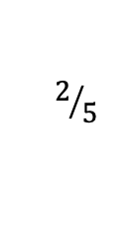
Methods and lemmas
Triangle.dfy
$$2/5$$
method Gauss(n: nat) returns (t: nat)
ensures t == Triangle(n)
ensures Triangle(n) == n * (n + 1) / 2
{
t := 0;
var i := 0;
while i < n
invariant 0 <= i <= n
invariant t == Triangle(i)
invariant Triangle(i) == i * (i + 1) / 2
{
i := i + 1;
t := t + i;
}
}

Slide 13
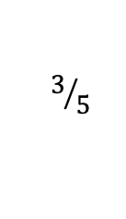
Methods and lemmas
Triangle.dfy
$$3/5$$
method Gauss(n: nat)
ensures Triangle(n) == n * (n + 1) / 2
{
var i := 0;
while i < n
invariant 0 <= i <= n
invariant Triangle(i) == i * (i + 1) / 2
{
i := i + 1;
}
}

Slide 14
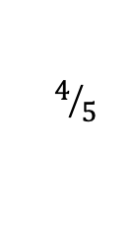
Methods and lemmas
Triangle.dfy
$$4/5$$
lemma Gauss(n: nat)
ensures Triangle(n) == n * (n + 1) / 2
{
var i := 0;
while i < n
invariant 0 <= i <= n
invariant Triangle(i) == i * (i + 1) / 2
{
i := i + 1;
}
}

Slide 15
lemma
≈ method
Stating and proving a lemma is just another application of program logic
(Note: not based on Curry-Howard correspondence)
For both methods and lemmas, you have to establish the postcondition for every input and every control path
Calling a method/lemma obtains the information from its postcondition (and, for methods, experiences any side effects)
Methods that call themselves are known as recursive
Lemmas that call themselves are known as inductive
These are really the same!

Slide 16
The need for termination: methods
method M(x: int)
ensures P(x)
{
M(x);
}
method Caller(x: int)
{
M(x);
assert P(x);
…
}
Lecture 1

Slide 17
The need for termination: lemmas
lemma L(x: int)
ensures P(x)
{
L(x);
}
method Caller(x: int)
{
L(x);
assert P(x);
…
}

Slide 18
The need for termination: functions
function F(x: int): int {
1 + F(x)
}
method Caller()
{
assert F(5) == 1 + F(5);
assert false;
…
}

Slide 19
How to establish termination
Main()
M(45, 10)
P(25)
Q(102)
S(10)
P(100)
M(45, 12)
R()
S(9)
…
M(31, 0)
S(8)
…

Slide 20
How to establish termination: associate a termination metric with each method activation
Main()
280
M(45, 10)
P(25)
63
275
Q(102)
229
S(10)
0
20
P(100)
M(45, 12)
274
R()
S(9)
227
100
…
M(31, 0)
S(8)
90
63
…

Slide 21
Desired property for each call
If each call
Caller()
x
Callee()
y
satisfies x ≻ y
in a fixed well-founded order ≻ ,
then all calls in the program terminate

Slide 22
Well-founded order
An irreflexive partial order ≻ on a set 𝒜 is
well-founded
if there is no infinite descending chain
a₀ ≻ a₁ ≻ a₂ ≻ a₃ ≻ …
Example: The natural numbers with the usual
greater-than ordering > is well-founded.

Slide 23
Defining termination metrics
A decreases clause defines the termination metric for each method/function activation
It is evaluated on entry to the method/function
method Apple(m: nat)
decreases 100 * m
{
if 1 <= m < 50 {
Banana(80 - m);
var c := Cherry(m);
}
}
method Banana(n: nat)
decreases n + 19
…
function Cherry(p: nat): nat
decreases p / 2
…
For an activation Apple(4)
Apple(4)
400
400 ≻ 95 ✅
Banana(76)
95
400 ≻ 2 ✅
Cherry(4)
2

Slide 24
Defining termination metrics
A decreases clause defines the termination metric for each method/function activation
It is evaluated on entry to the method/function
method Apple(m: nat)
decreases 100 * m
{
if 1 <= m < 50 {
Banana(80 - m);
var c := Cherry(m);
}
}
method Banana(n: nat)
decreases n + 19
…
function Cherry(p: nat): nat
decreases p / 2
…
For a general activation of Apple
Apple(m)
100 * m
100 * m ≻ 99 - m
✅
Banana(80 - m)
99 - m
100 * m ≻ m / 2
✅
Cherry(m)
m / 2

Slide 25
Examples
function Triangle(n: nat): nat
decreases n
{
if n == 0 then 0 else n + Triangle(n - 1)
}
function Factorial(n: nat): nat
decreases n
{
if n > 0 then n * Factorial(n - 1) else 1
}
function Fib(n: nat): nat
decreases n
{
if n < 2 then n else Fib(n - 2) + Fib(n - 1)
}

Slide 26
Default decreases clause
function Triangle(n: nat): nat
decreases n
{
if n == 0 then 0 else n + Triangle(n - 1)
}
function Factorial(n: nat): nat
decreases n
{
if n > 0 then n * Factorial(n - 1) else 1
}
function Fib(n: nat): nat
decreases n
{
if n < 2 then n else Fib(n - 2) + Fib(n - 1)
}
An omitted decreases clause defaults to the method/function parameter
/////
(n:

Slide 27
More examples
SumRange.dfy
  Manual decreases clause
function SumRange(s: seq<int>, lo: int, hi: int): int
requires 0 <= lo <= hi <= |s|
decreases hi - lo
{
if hi == lo then 0 else s[lo] + SumRange(s, lo+1, hi)
}

Slide 28
More examples
Fib.dfy
  Non-standard base cases
function Fib(n: nat): nat {
if n < 2 then n else Fib(n - 2) + Fib(n - 1)
}
lemma {:induction false} FibProperty(n: nat)
requires 5 <= n
ensures n <= Fib(n)
{
if n == 5 {
} else if n == 6 {
} else {
FibProperty(n - 2);
FibProperty(n - 1);
}
}

Slide 29
More examples
Pow.dfy
  More interesting proof
// Return 2^{n}
opaque function Pow(n: nat): nat
{
if n == 0 then 1 else 2 * Pow(n - 1)
}
lemma PowDistributesOverAddition(m: nat, n: nat)
ensures Pow(m + n) == Pow(m) * Pow(n)
{
if m == 0 {
reveal Pow(); // def. Pow
} else {
calc {
Pow(m + n);
== { reveal Pow(); } // def. Pow
2 * Pow(m - 1 + n);
== { PowDistributesOverAddition(m - 1, n); } // I.H.
2 * (Pow(m - 1) * Pow(n));
==
2 * Pow(m - 1) * Pow(n);
== { reveal Pow(); } // def. Pow
Pow(m) * Pow(n);
}
}
}

Slide 30
More examples
Pow.dfy
  Strong induction
opaque function FastPow(n: nat): nat {
if n == 0 then
1
else
var p := FastPow(n / 2);
if n % 2 == 0 then
p * p
else
2 * p * p
}
lemma Same(n: nat)
ensures FastPow(n) == Pow(n)
{
if n == 0 {
reveal Pow(), FastPow();
} else {
var p := FastPow(n / 2);
var q := Pow(n / 2);
calc {
FastPow(n);
== { reveal FastPow(); }
if n % 2 == 0 then p * p else 2 * p * p;
== { Same(n / 2); }
if n % 2 == 0 then q * q else 2 * q * q;
== { PowDistributesOverAddition(n / 2, n / 2); }
if n % 2 == 0 then Pow(n) else 2 * Pow(n - 1);
== { reveal Pow(); }
if n % 2 == 0 then Pow(n) else Pow(n);
==
Pow(n);
}
}
}

Slide 31
Well-founded order for datatypes
Inductive datatypes are ordered by structural inclusion
Example:
datatype List<X> = Nil | Cons(T, List<X>)
Cons(head, tail) ≻ head (*)
Cons(head, tail) ≻ tail
(*) provided head is a datatype value
Lecture 2

Slide 32
Datatype examples
List.dfy
  Datatypes
datatype List<X> = Nil | Cons(head: X, tail: List<X>)
opaque function Length(xs: List): nat {
match xs
case Nil => 0
case Cons(_, tail) => 1 + Length(tail)
}
opaque function Append(xs: List, ys: List): List {
match xs
case Nil => ys
case Cons(x, tail) => Cons(x, Append(tail, ys))
}
lemma {:induction false} AppendLength(xs: List, ys: List)
ensures Length(Append(xs, ys)) == Length(xs) + Length(ys)
{
match xs
case Nil =>
reveal Length(), Append(); // defs. Length, Append
case Cons(x, tail) =>
calc {
Length(Append(xs, ys));
== // what xs is
Length(Append(Cons(x, tail), ys));
== { reveal Append(); } // def. Append
Length(Cons(x, Append(tail, ys)));
== { reveal Length(); } // def. Length
1 + Length(Append(tail, ys));
== { AppendLength(tail, ys); } // I.H.
1 + Length(tail) + Length(ys);
== { reveal Length(); } // def. Length
Length(Cons(x, tail)) + Length(ys);
== // what xs is
Length(xs) + Length(ys);
}
}

Slide 33
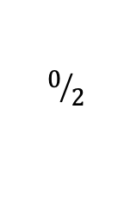
Datatype examples
AST.dfy
  Mutual recursion, mutual induction
$$0/2$$
datatype List<X> = Nil | Cons(head: X, tail: List<X>)
datatype Expr =
| Const(c: int)
| Var(name: string)
| Node(op: Operator, args: List<Expr>)
type Operator
function Subst(e: Expr, name: string, x: int): Expr
{
match e
case Const(_) => e
case Var(n) => if n == name then Const(x) else e
case Node(op, args) => Node(op, SubstList(args, name, x))
}
function SubstList(es: List<Expr>, name: string, x: int): List<Expr>
{
match es
case Nil => Nil
case Cons(e, tail) => Cons(Subst(e, name, x), SubstList(tail, name, x))
}

Slide 34
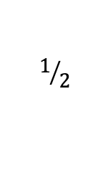
Datatype examples
AST.dfy
  Mutual recursion, mutual induction
$$1/2$$
lemma SubstIdempotent(e: Expr, name: string, x: int)
ensures Subst(Subst(e, name, x), name, x) == Subst(e, name, x)
{
match e
case Const(_) =>
case Var(_) =>
case Node(op, args) =>
SubstListIdempotent(args, name, x);
}
lemma SubstListIdempotent(es: List<Expr>, v: string, c: int)
ensures SubstList(SubstList(es, v, c), v, c) == SubstList(es, v, c)
{
match es
case Nil =>
case Cons(e, tail) =>
calc {
SubstList(SubstList(es, v, c), v, c);
== // def. inner SubstList
SubstList(Cons(Subst(e, v, c), SubstList(tail, v, c)), v, c);
== // def. outer SubstList
Cons(Subst(Subst(e, v, c), v, c), SubstList(SubstList(tail, v, c), v, c));
== { SubstIdempotent(e, v, c); }
Cons(Subst(e, v, c), SubstList(SubstList(tail, v, c), v, c));
== { SubstListIdempotent(tail, v, c); }
Cons(Subst(e, v, c), SubstList(tail, v, c));
== // def. SubstList
SubstList(es, v, c);
}
}

Slide 35
Well-founded ordered for other types
type | X ≻ y
inductive datatype | X structurally includes y
int
real
bool
object?
set<T>
seq<T>
iset<T>

Slide 36
Well-founded ordered for other types
type | X ≻ y
inductive datatype | X structurally includes y
int | 0 ≤ X ⋀ y < X
real
bool
object?
set<T>
seq<T>
iset<T>
Example: Water.dfy

Slide 37
Example
Water.dfy
  Using an integer offset
method AntarcticCooling(temperatureIn: int) returns (temperatureOut: int)
decreases temperatureIn + 2
{
if -1 <= temperatureIn {
temperatureOut := AntarcticCooling(temperatureIn - 1);
} else {
temperatureOut := temperatureIn;
}
}

Slide 38
Well-founded ordered for other types
type | X ≻ y
inductive datatype | X structurally includes y
int | 0 ≤ X ⋀ y < X equivalently: 0 ≤ X ⋀ y + 1 ≤ X
real
bool
object?
set<T>
seq<T>
iset<T>

Slide 39
Well-founded ordered for other types
type | X ≻ y
inductive datatype | X structurally includes y
int | 0 ≤ X ⋀ y < X equivalently: 0 ≤ X ⋀ y + 1 ≤ X
real | 0.0 ≤ X ⋀ y + 1.0 ≤ X
bool
object?
set<T>
seq<T>
iset<T>

Slide 40
Well-founded ordered for other types
type | X ≻ y
inductive datatype | X structurally includes y
int | 0 ≤ X ⋀ y < X equivalently: 0 ≤ X ⋀ y + 1 ≤ X
real | 0.0 ≤ X ⋀ y + 1.0 ≤ X
bool | X ⋀ ¬y
object?
set<T>
seq<T>
iset<T>
Example: Xy.dfy

Slide 41
Example
Xy.dfy
  Interesting decreases clauses
// In Lustre:
// x = if c then y else 0
// y = if c then 1 else x
function x(c: bool): int
decreases c
{
if c then y(c) else 0
}
function y(c: bool): int
decreases !c
{
if c then 1 else x(c)
}

Slide 42
Well-founded ordered for other types
type | X ≻ y
inductive datatype | X structurally includes y
int | 0 ≤ X ⋀ y < X equivalently: 0 ≤ X ⋀ y + 1 ≤ X
real | 0.0 ≤ X ⋀ y + 1.0 ≤ X
bool | X ⋀ ¬y
object? | X ≠ null ⋀ y = null
set<T>
seq<T>
iset<T>

Slide 43
Well-founded ordered for other types
type | X ≻ y
inductive datatype | X structurally includes y
int | 0 ≤ X ⋀ y < X equivalently: 0 ≤ X ⋀ y + 1 ≤ X
real | 0.0 ≤ X ⋀ y + 1.0 ≤ X
bool | X ⋀ ¬y
object? | X ≠ null ⋀ y = null
set<T> | y ⊊ X
seq<T>
iset<T>

Slide 44
Well-founded ordered for other types
type | X ≻ y
inductive datatype | X structurally includes y
int | 0 ≤ X ⋀ y < X equivalently: 0 ≤ X ⋀ y + 1 ≤ X
real | 0.0 ≤ X ⋀ y + 1.0 ≤ X
bool | X ⋀ ¬y
object? | X ≠ null ⋀ y = null
set<T> | y ⊊ X
seq<T> | Y is proper subsequence of X
iset<T>

Slide 45
Well-founded ordered for other types
type | X ≻ y
inductive datatype | X structurally includes y
int | 0 ≤ X ⋀ y < X equivalently: 0 ≤ X ⋀ y + 1 ≤ X
real | 0.0 ≤ X ⋀ y + 1.0 ≤ X
bool | X ⋀ ¬y
object? | X ≠ null ⋀ y = null
set<T> | y ⊊ X
seq<T> | Y is proper subsequence of X
iset<T> | false

Slide 46
Union of types
Let (𝒜, ≻_{𝒜}) and (ℬ, ≻_{ℬ}) be well-founded orders, where 𝒜 and ℬ are disjoint.
Define ≻ on 𝒜 ∪ ℬ by
x ≻ y = x ≻_{𝒜} y ∨ x ≻_{ℬ} y
Then, (𝒜 ∪ ℬ, ≻) is also a well-founded order.

Slide 47
Top element
Let (𝒜, ≻) be a well-founded order.
Let ⊤ denote an element not in 𝒜.
Define 𝒜⊤ to be 𝒜 ∪ {⊤}.
Define ≻⊤ on 𝒜⊤ by
x ≻⊤ y = x ≻ y ∨ (x = ⊤ ∧ y ≠ ⊤)
Then, (𝒜⊤, ≻⊤) is also a well-founded order.

Slide 48
Lexicographic orders
Let (𝒜, ≻_{𝒜}), (ℬ, ≻_{ℬ}), and (𝒞, ≻_{𝒞}) be well-founded orders.
Define ≻ on the (so-called lexicographic) tuples 𝒜 × ℬ × 𝒞 by
a0, b0, c0 ≻ a1, b1, c1
=
a0 ≻_{𝒜} a1 ∨
(a0 = a1 ∧ b0 ≻_{ℬ} b1) ∨
(a0 = a1 ∧ b0 = b1 ∧ c0 ≻_{𝒞} c1)
Then, (𝒜 × ℬ × 𝒞, ≻) is a well-founded order.

Slide 49
Lexicographic tuples of different lengths
How to compare elements of ℤ⁵ and ℤ⁷ ?
Examples:
  9, 2, 2, 7, 1 ≻ 8, 6, 7, 5, 3, 0, 9 (a)
  8, 6, 7, 5, 3 ≻ 8, 6, 7, 5, 3, 0, 9 (b)
Some candidates:
  Shorter always smaller
  For equal prefixes, shorter is smaller
  For equal prefixes, shorter is larger (*)
  Pad with ⊤ and then compare the equal lengths (*)
?
?
(*) Provided there’s an upper bound on the length
Lecture 3

Slide 50
Examples
Pad with ⊤ and then compare the equal lengths
  9, 2, 2, 7, 1 ≻ 8, 6, 7, 5, 3, 0, 9
  =
  9, 2, 2, 7, 1, ⊤, ⊤ ≻ 8, 6, 7, 5, 3, 0, 9
  8, 6, 7, 5, 3 ≻ 8, 6, 7, 5, 3, 0, 9
  =
  8, 6, 7, 5, 3, ⊤, ⊤ ≻ 8, 6, 7, 5, 3, 0, 9
  8, 6, 7, 5, 3, 0, 9 ≻ 9, 2, 2, 7, 1
  =
  8, 6, 7, 5, 3, 0, 9 ≻ 9, 2, 2, 7, 1, ⊤, ⊤
Note that additional ⊤-padding does not change anything
  a, b, c, d, e ≻ v, w, x, y, z
  =
  a, b, c, d, e, ⊤ ≻ v, w, x, y, z, ⊤
(true)
(true)
(false)

Slide 51
Termination metrics in Dafny
Dafny fixes a well-founded order for each type
Its termination metrics use ^{(*)}
𝒜⊤ × 𝒜⊤ × ⋯ × 𝒜⊤
where 𝒜 is the union of all types and
k is the length of the longest given decreases clause in the program
decreases clauses are automatically ⊤-padded to the longest length
k
(*) Almost. One addition added in later lecture.

Slide 52
Example: Ackermann
function Ack(m: nat, n: nat): nat
decreases m, n
{
if m == 0 then
n + 1
else if n == 0 then
Ack(m - 1, 1)
else
Ack(m - 1, Ack(m, n - 1))
}
m, n ≻ m-1, 1 ✅
m, n ≻ m, n-1 ✅
m, n ≻ m-1, … ✅

Slide 53
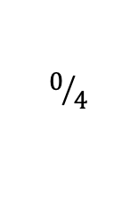
Example
CountPs.dfy
  Call chains
$$0/4$$
function P(x: int): bool
//...
// Count the number of values less than "n" that satisfy "P"
function CountPs(n: nat): int
{
if n == 0 then
0
else if P(n - 1) then
1 + CountPs(n - 1)
else
CountPs(n - 1)
}

Slide 54
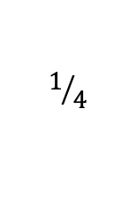
Example
CountPs.dfy
  Call chains
$$1/4$$
function P(x: int): bool
//...
// Count the number of values less than "n" that satisfy "P"
function CountPs(n: nat): int
decreases n, 1
{
if n == 0 then
0
else if P(n - 1) then
AddAndCountTheRest(n, 1)
else
AddAndCountTheRest(n, 0)
}
function AddAndCountTheRest(n: nat, x: int): int
requires n != 0
decreases n, 0
{
x + CountPs(n - 1)
}

Slide 55
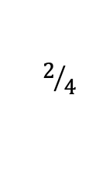
Example
CountPs.dfy
  Call chains
$$2/4$$
function P(x: int): bool
//...
// Count the number of values less than "n" that satisfy "P"
function CountPs(n: nat): int
decreases n
{
if n == 0 then
0
else if P(n - 1) then
AddAndCountTheRest(n, 1)
else
AddAndCountTheRest(n, 0)
}
function AddAndCountTheRest(n: nat, x: int): int
requires n != 0
decreases n, x
{
x + CountPs(n - 1)
}

Slide 56
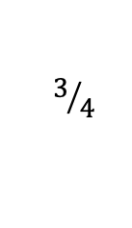
Example
CountPs.dfy
  Call chains
$$3/4$$
function P(x: int): bool
//...
// Count the number of values less than "n" that satisfy "P"
function CountPs(n: nat): int
{
if n == 0 then
0
else if P(n - 1) then
AddAndCountTheRest(n, 1)
else
AddAndCountTheRest(n, 0)
}
function AddAndCountTheRest(n: nat, x: int): int
requires n != 0
{
x + CountPs(n - 1)
}

Slide 57
Example
CombineBudget.dfy
  Limited increases
method Combine(a: nat, b: nat, incBudget: nat) returns (c: nat)
ensures c == 100 * a + b
decreases incBudget, a, b
{
if a == 0 {
c := b;
} else if b != 0 {
c := Combine(a, b - 1, incBudget);
c := c + 1;
} else if 5000 <= b && incBudget != 0 {
c := Combine(a + 1, b - 100, incBudget - 1);
} else {
c := Combine(a - 1, b + 100, incBudget);
}
}

Slide 58
Example
Mult.dfy
lemma {:induction false} MultCommutative(x: nat, y: nat)
ensures Mult(x, y) == Mult(y, x)
decreases x, y
{
if x == y {
} else if x == 0 {
assert Mult(x, y) == Mult(x, y - 1);
assert Mult(y, x) == 0 == Mult(y - 1, x);
MultCommutative(x, y - 1);
} else if y < x {
MultCommutative(y, x);
} else {
calc {
Mult(x, y);
== // def. Mult
x + Mult(x, y - 1);
== { MultCommutative(x, y - 1); }
x + Mult(y - 1, x);
== // def. Mult
x + y - 1 + Mult(y - 1, x - 1);
== { MultCommutative(x - 1, y - 1); }
x + y - 1 + Mult(x - 1, y - 1);
== // def. Mult
y + Mult(x - 1, y);
== { MultCommutative(x - 1, y); }
y + Mult(y, x - 1);
== // def. Mult
Mult(y, x);
}
}
}
function Mult(x: nat, y: nat): nat {
if y == 0 then 0 else x + Mult(x, y - 1)
}
How cool is this step?
Yep, pretty cool, alright!
Here’s another interesting step. Notice how the arguments are reversed in the recursive call (that is, to call to the induction hypothesis).

Slide 59
Example
Drop.dfy
$$0/2$$
datatype List<X> = Nil | Cons(head: X, tail: List<X>)
function Length(xs: List): nat {
if xs == Nil then 0 else 1 + Length(xs.tail)
}
function Drop(xs: List, n: nat): List
requires n <= Length(xs)
{
if n == 0 then xs else Drop(xs.tail, n - 1)
}
function Drop'(xs: List, n: nat): (r: List)
requires n <= Length(xs)
ensures Length(r) == Length(xs) - n
{
if n == 0 then xs else Drop'(xs, n - 1).tail
}

Slide 60
Example
Drop.dfy
  Notice the 3 different uses of the inductive hypothesis
$$1/2$$
lemma {:induction false} Same(xs: List, n: nat)
requires n <= Length(xs)
ensures Drop(xs, n) == Drop'(xs, n)
{
if n < 2 {
// easy
} else {
calc {
Drop(xs, n);
== // def. Drop
Drop(xs.tail, n - 1);
== { Same(xs.tail, n - 1); } // I.H.
Drop'(xs.tail, n - 1);
== // def. Drop'
Drop'(xs.tail, n - 2).tail;
== { Same(xs.tail, n - 2); } // I.H.
Drop(xs.tail, n - 2).tail;
== // def. Drop
Drop(xs, n - 1).tail;
== { Same(xs, n - 1); } // I.H.
Drop'(xs, n - 1).tail;
== // def. Drop'
Drop'(xs, n);
}
}
}

Slide 61
Layering methods/functions
Given
function Fib(n: nat): nat
decreases n
{
if n < 2 then n else Fib(n-2) + Fib(n-1)
}
Specify termination of
function SumOfFibs(xs: List<nat>): nat
decreases ??
{
if xs == Nil then 0 else
Fib(xs.head) + SumOfFibs(xs.tail)
}

Slide 62
Layering methods/functions
One possibility:
function Fib(n: nat): nat
decreases 0, n
{
if n < 2 then n else Fib(n-2) + Fib(n-1)
}
function SumOfFibs(xs: List<nat>): nat
decreases 1, xs
{
if xs == Nil then 0 else
Fib(xs.head) + SumOfFibs(xs.tail)
}
But this requires changing the given specification of Fib 😟

Slide 63
Call graph
F
Gold
H
J
G
K
Cumquat
Emerald
SumOfFibs
Gold ≻ Cumquat
Gold ≻ Emerald
Emerald ≻ Rose
Rose ≻ Cyan
Rose
Fib
Cyan

Slide 64
Termination metrics in Dafny
(updated)
Dafny fixes a well-founded order for each type
Its termination metrics use
𝒞 × 𝒜⊤ × 𝒜⊤ × ⋯ × 𝒜⊤
where
  𝒜 is the union of all types
  𝒞 is the set of strongest connected components (SCCs) of the call graph
  k is the length of the longest given decreases clause in the program
decreases clauses are automatically padded to the longest length
k

Slide 65
Layering methods/functions
Solution
function Fib(n: nat): nat
decreases n
{
if n < 2 then n else Fib(n-2) + Fib(n-1)
}
function SumOfFibs(xs: List<nat>): nat
decreases xs
{
if xs == Nil then 0 else
Fib(xs.head) + SumOfFibs(xs.tail)
}

Slide 66
Summary
You can call whatever you want whenever you want, provided
  you satisfy the precondition, and
  you can show a decrease in some fixed well-founded order
Examples:
  n <= Fib(n): base cases 5, 6
  FastPow: strong induction
  SubstIdempotent: mutual recursion/induction
  x/y: custom ordering
  MultComm: ad-hoc cases
  Call chains: use constants, call-graph SCC
Program safely!

